Slide 1

Proposed use case: Device Map & Prioritization

Slide 2
A starting point: Device prioritization API
Device prioritization: Updates the device prioritization status in Home network scenario
App Launched
API2: Change Prioritization of a device
The customer logs in and gives her consent
API1: Device Map

Slide 3
Device prioritization API – Why it’s important
Network performance impacts on digital services QoE (Quality of Experience)
While at home, several devices are demanding resources, with different expectations/needs: VideoComms, Cloud Gaming, VR.
Sample use case:
User with a VR Device uses an App offered by the Capability Consumer (App Provider)…
… while in the User Home → other devices are connected simultaneously to the Home Network
the App needs the VR Device traffic to be prioritized over other devices traffic in the same network

Slide 4
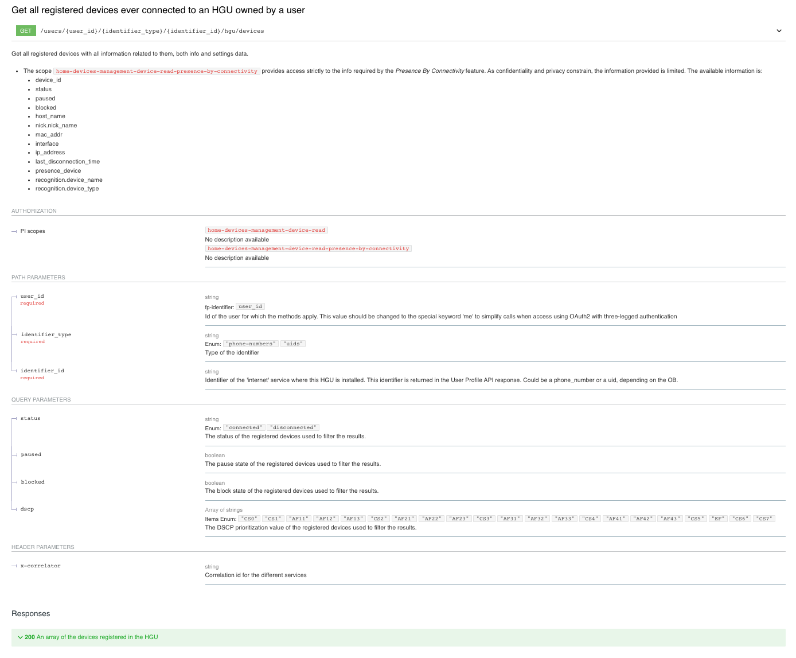
API Specification: Device Map
Map: devices connected to home network
Basics
user_id & identifier to identify the home router
devices collection to fetch devices map
Request prioritization of the device indicating dscp
API proposed as base for standardization

Slide 5
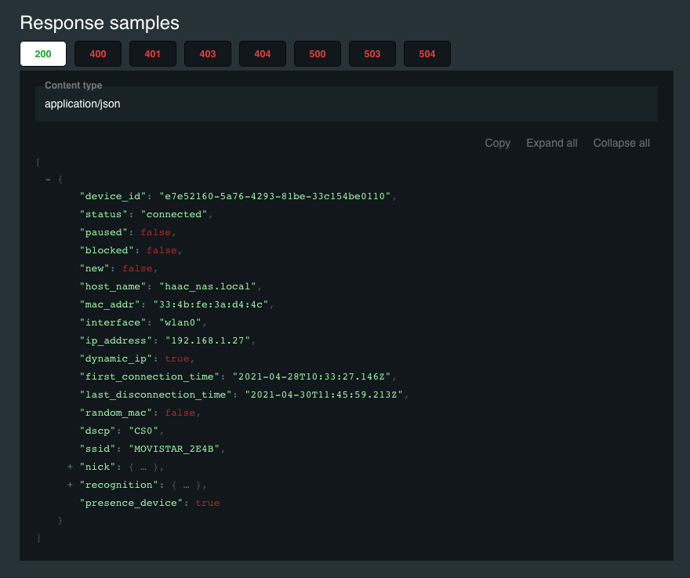
API Specification: Device Map
Response provides each device_id
Plus other info
API proposed as base for standardization

Slide 6
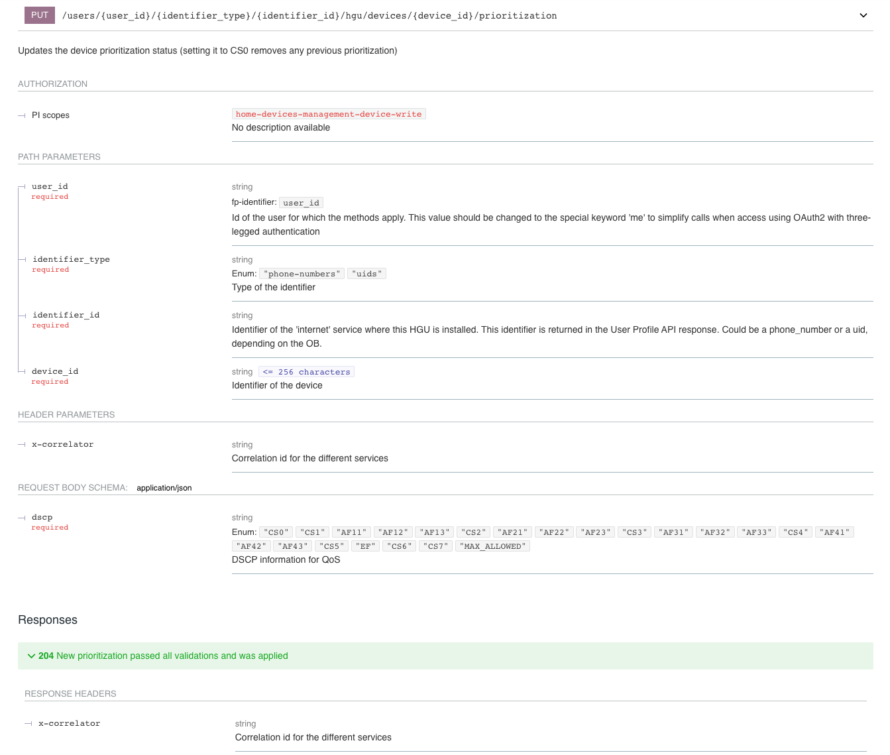
API Specification: Device Prioritization
Basics
user_id & identifier to identify the home router
device_id to refer to a device (got from the map)
Request prioritization of the device indicating dcsp
API proposed as base for standardization

